Slide 1
Genetic Algorithm

Slide 2
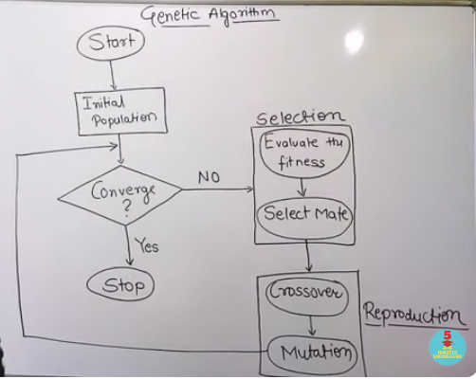
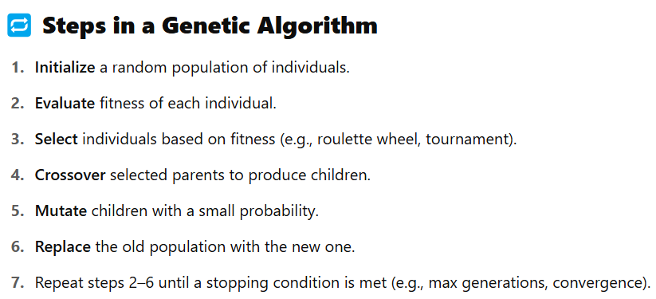
Genetic Algorithm Explained With Flowchart
offspring

Slide 3
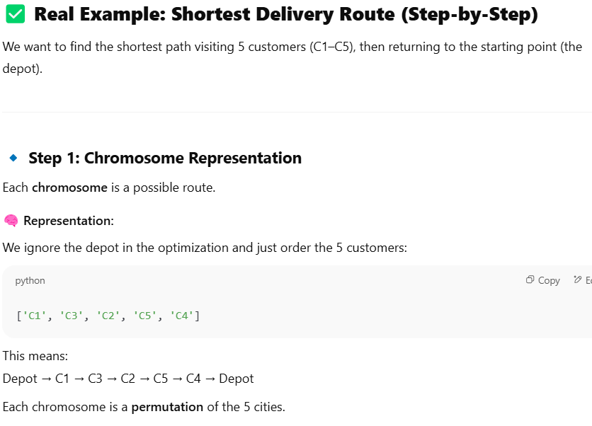
Genetic Algorithm Explained With Flowchart
offspring

Slide 4
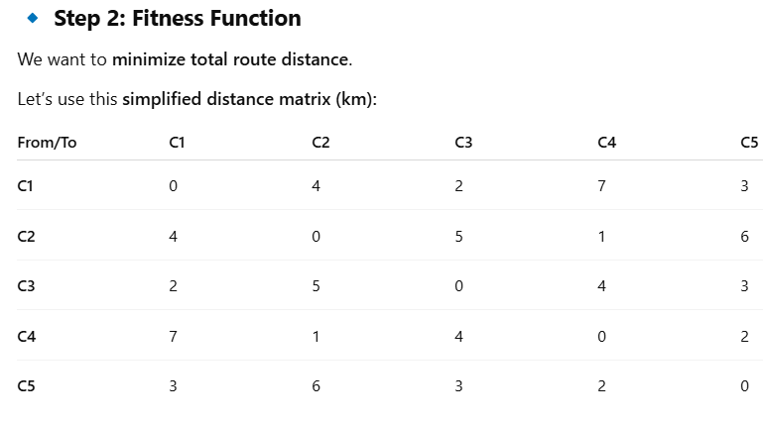
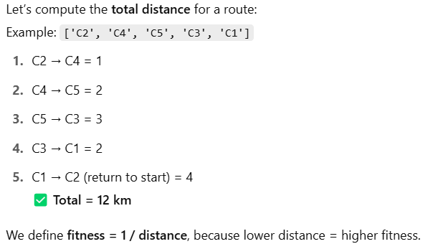
Genetic Algorithm Explained With Flowchart
offspring

Slide 5
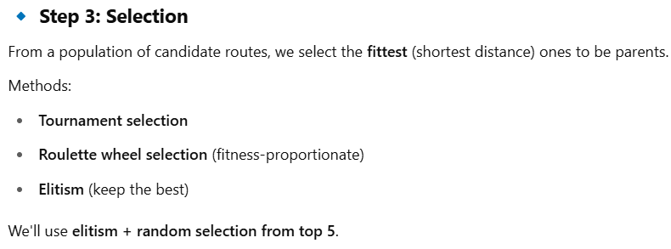
Genetic Algorithm Explained With Flowchart

Slide 6
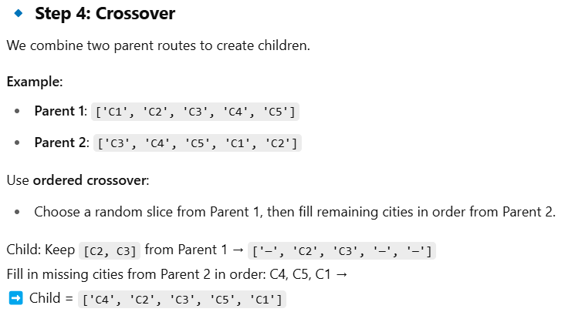
Genetic Algorithm Explained With Flowchart

Slide 7
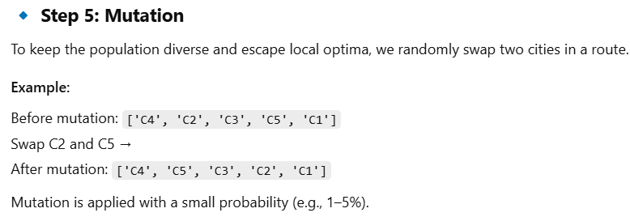
Genetic Algorithm Explained With Flowchart

Slide 8
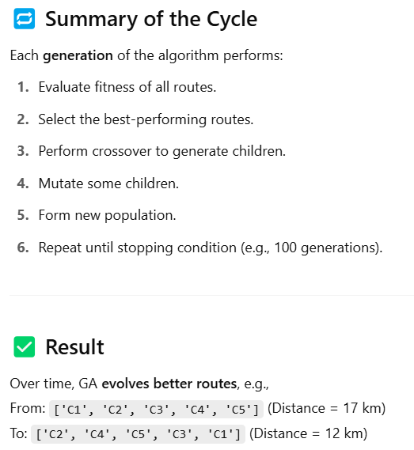
Genetic Algorithm Explained With Flowchart

Slide 9
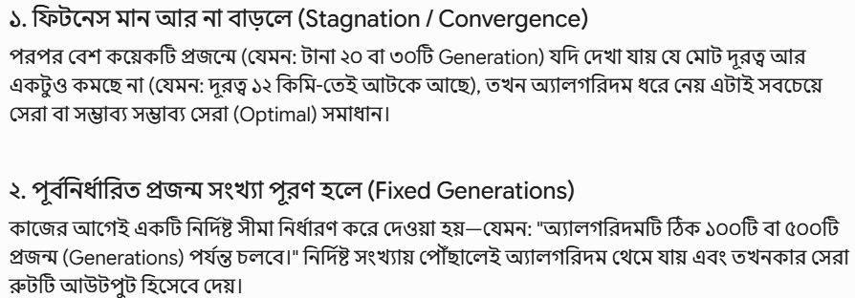
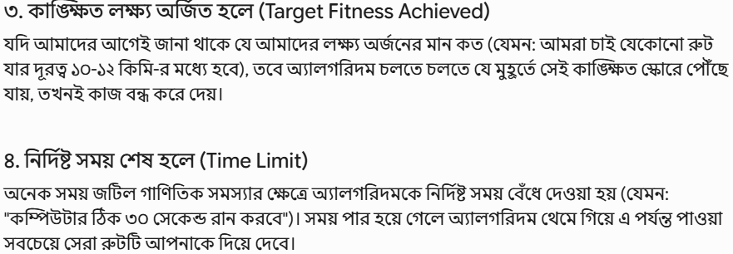
Stopping Condition

Slide 10
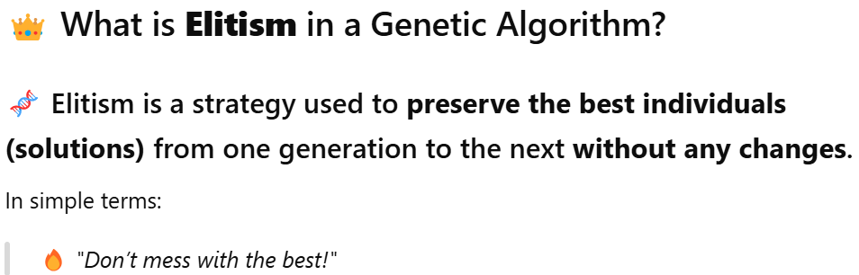
Genetic Algorithm Explained With Flowchart
(অর্থাৎ, সেরা সমাধানটি নিয়ে কোনো নাড়াচাড়া করা যাবে না!)

Slide 11
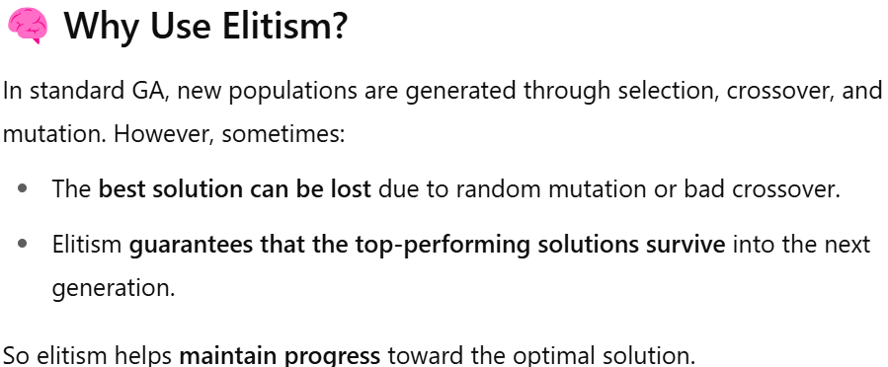
Genetic Algorithm Explained With Flowchart

Slide 12
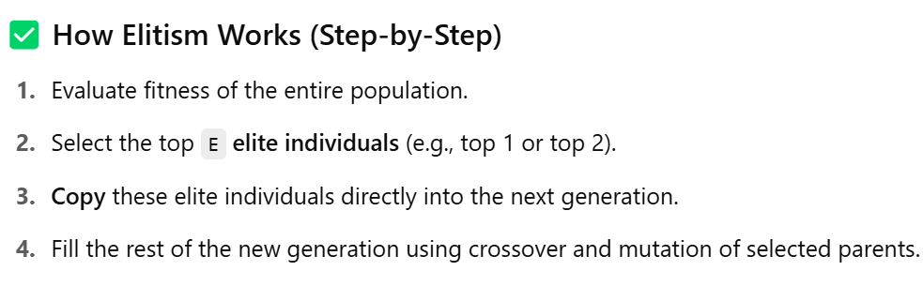
Genetic Algorithm Explained With Flowchart

Slide 13
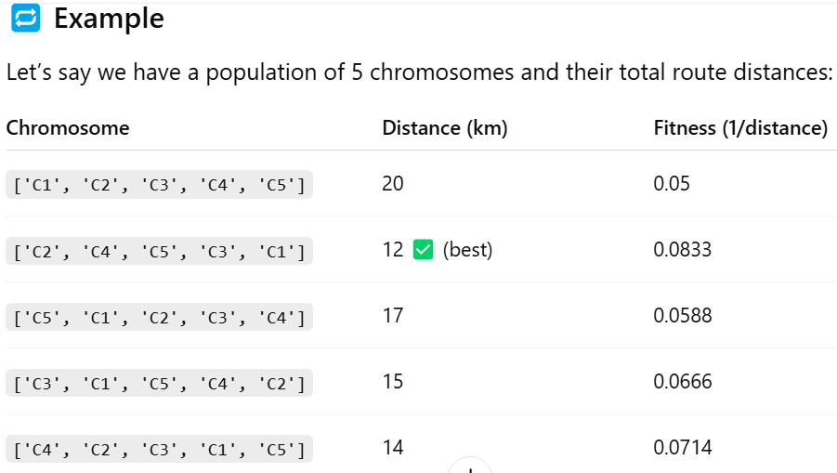
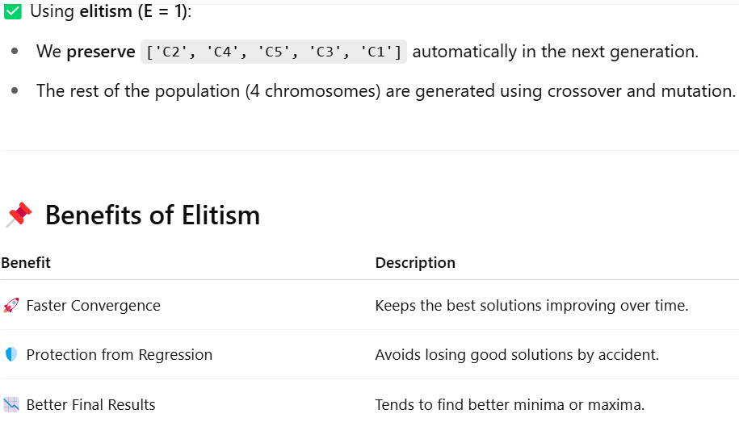
Genetic Algorithm Explained With Flowchart

Slide 14
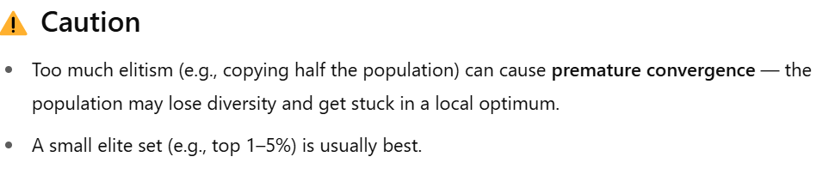
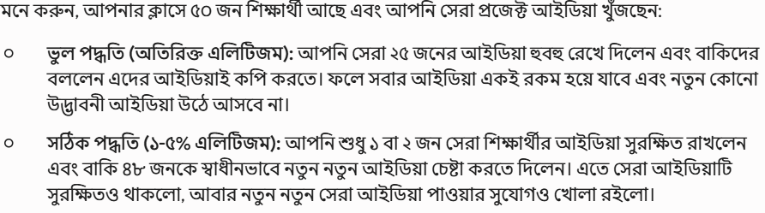
Genetic Algorithm Explained With Flowchart

Slide 15
Genetic Algorithm Explained With Flowchart
https://www.youtube.com/watch?v=nas28_u-dJw

Slide 16
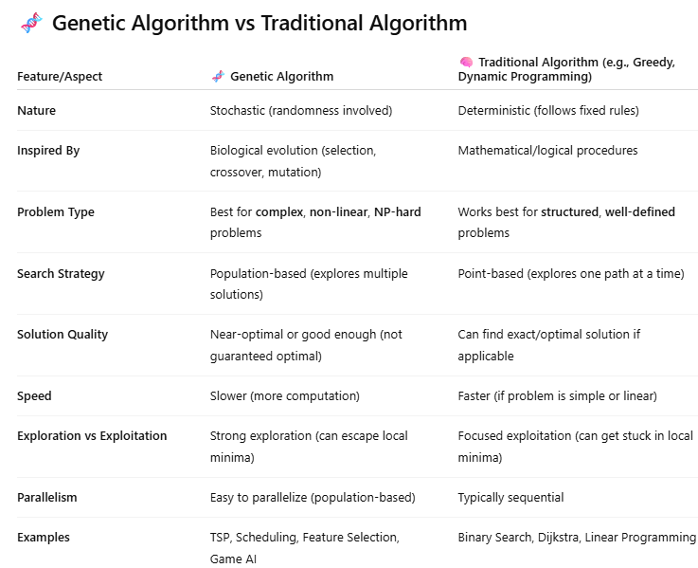
Genetic Algorithm Vs Traditional Algorithm

Slide 17
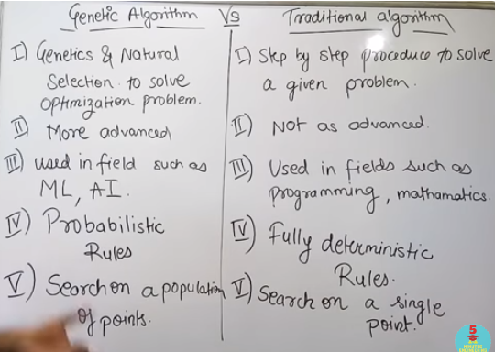
Genetic Algorithm Vs Traditional Algorithm
Specially in case of optimization problem
No of steps are finite

Slide 18
Genetic Algorithm Vs Traditional Algorithm
https://www.youtube.com/watch?v=ew0kqWuNpMo

Slide 19
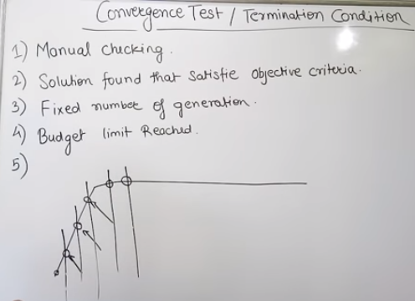
Convergence Criteria / Termination Condition in Genetic Algorithm

Slide 20
https://www.youtube.com/watch?v=lQz9oVot6fE

Slide 21
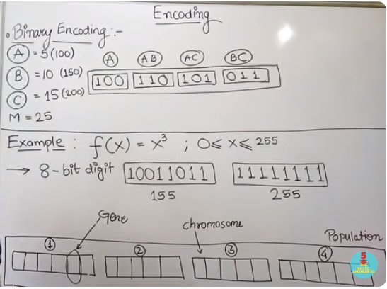
Encoding Technique : Binary Encoding in Genetic Algorithm

Slide 22
https://www.youtube.com/watch?v=2cPwk4fBAUA

Slide 23
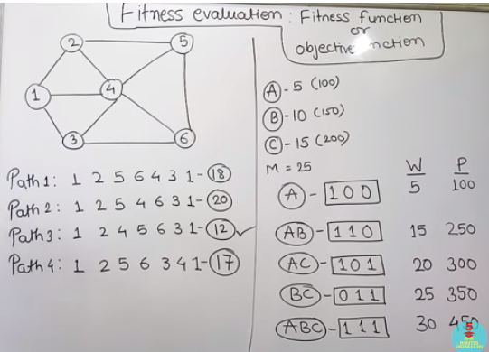
Fitness Evaluation : Fitness Function / Objective Function
0/1 Knapsack Problem
travelling salesman problem
objective function-shortest
path
Constraints-all city once
Visit & return to starting
point

Slide 24
https://www.youtube.com/watch?v=6xsxHr6e0zY

